Slide 1
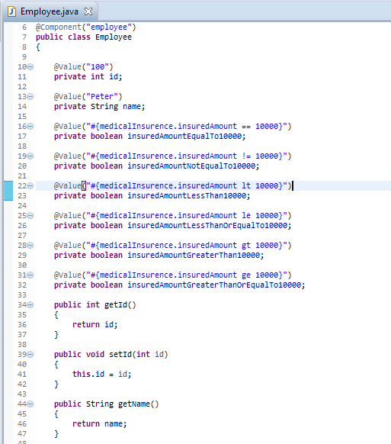
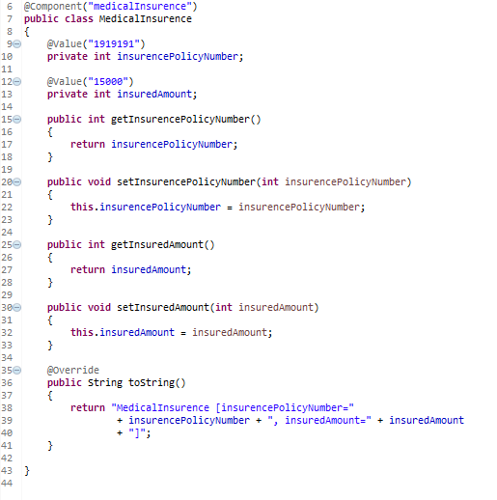
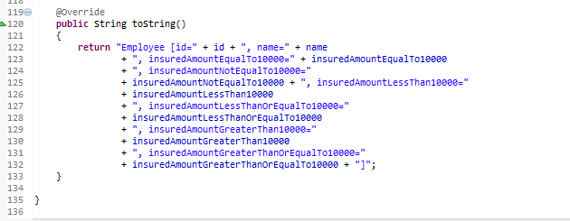
Spring EL Relational Operators
Spring EL supports Relational operators – equal (==, eq), not equal (!=, ne), less than (<, lt), less than or equal (<= , le), greater than (>, gt), and greater than or equal (>=, ge).
…
…

Slide 2
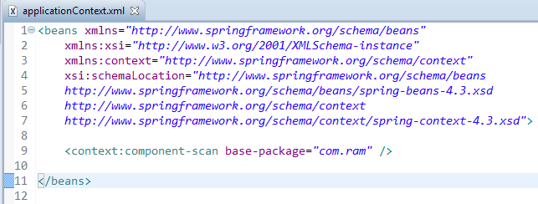
Spring EL Relational Operators
Enable auto component scanning.

Slide 3
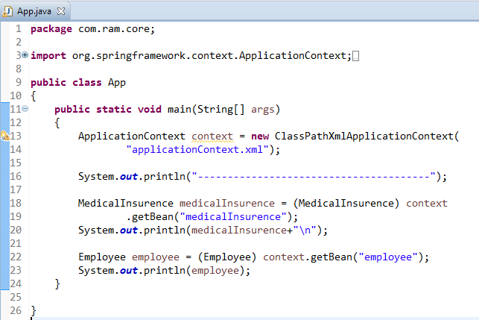
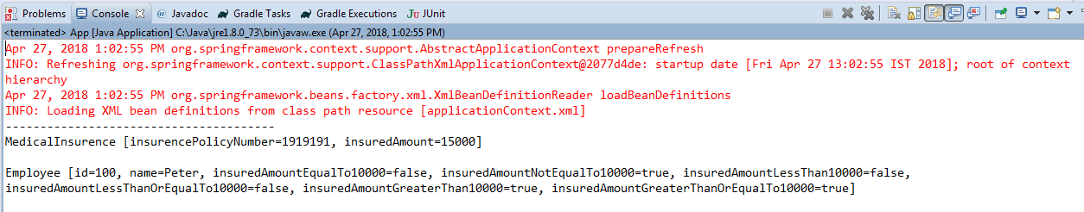
Spring EL Relational Operators

